Slide 1

6th Grade Math
Unit 6, Lesson 7 Using Three-Column Tables of Equivalent Ratios Volume 1, pg. 287

Slide 2


Benchmarks
MA.6.AR.3.3
Extend previous understanding of fractions and numerical patterns to generate or complete a two- or three-column table to display equivalent part-to-part ratios and part-to-part-to-whole ratios.
MA.6.AR.3.5
Solve mathematical and real-world problems involving ratios, rates, and unit rates, including comparisons, mixtures, ratios of lengths and conversions within the same measurement system.
volume 1, pg. 287

Slide 3
Integrated Mathematical Thinking and Reasoning Standards
MA.K12.MTR.5.1 Use patterns and structure to help understand and connect mathematical concepts.
MA.K12.MTR.7.1 Apply mathematics to real-world contexts.
volume 1, pg. 287

Slide 4

Learning Targets
I can use three-column tables to display equivalent ratios.
I can solve problems using three-column tables of equivalent ratios.
volume 1, pg. 287

Slide 5

Warm-Up
volume 1, pg. 288

Slide 6
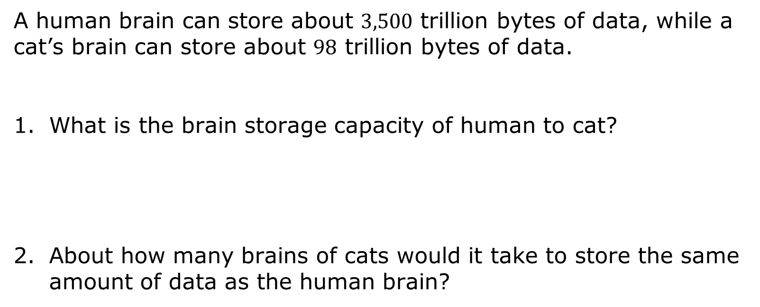
6.7.1 Warm-Up: Brain Capacity
A human brain can store about $3,500$ trillion bytes of data, while a cat’s brain can store about $98$ trillion bytes of data.
What is the brain storage capacity of human to cat?
About how many brains of cats would it take to store the same amount of data as the human brain?
volume 1, pg. 288

Slide 7

Guided Instruction
volume 1, pg. 288

Slide 8
6.7.2 Guided Instruction: Using Three-Column Ratio Tables
Ratios can be used to make part-to-part or part-to-whole comparisons. When comparing parts of a mixture to the whole, three-column ratio tables can be useful to represent the relationships between quantities.
volume 1, pg. 288

Slide 9
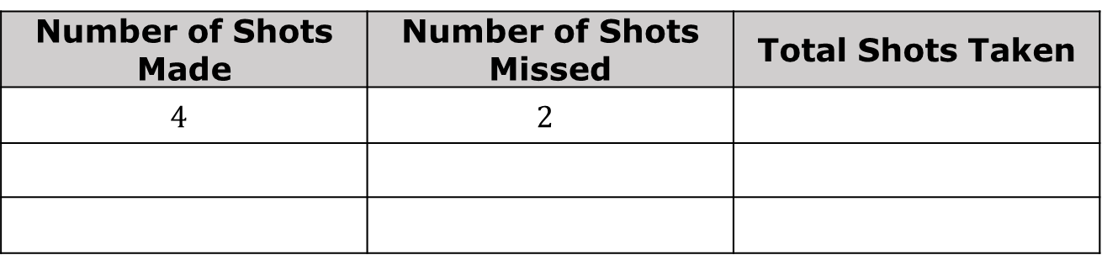
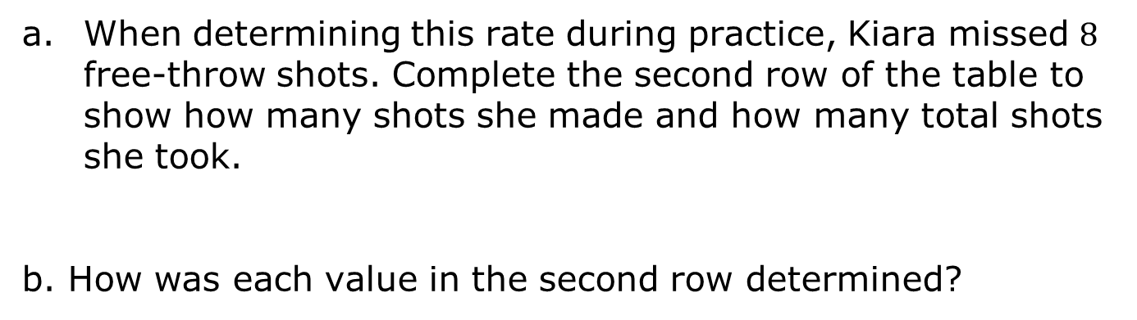
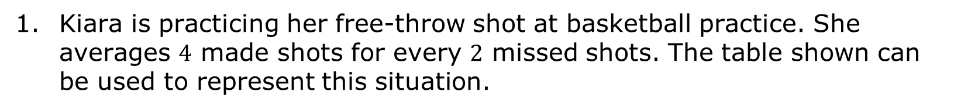
Kiara is practicing her free-throw shot at basketball practice. She averages $4$ made shots for every $2$ missed shots. The table shown can be used to represent this situation.
Number of Shots Made | Number of Shots Missed | Total Shots Taken
$$4$$ | $$2$$
When determining this rate during practice, Kiara missed $8$ free-throw shots. Complete the second row of the table to show how many shots she made and how many total shots she took.
How was each value in the second row determined?
volume 1, pg. 288

Slide 10
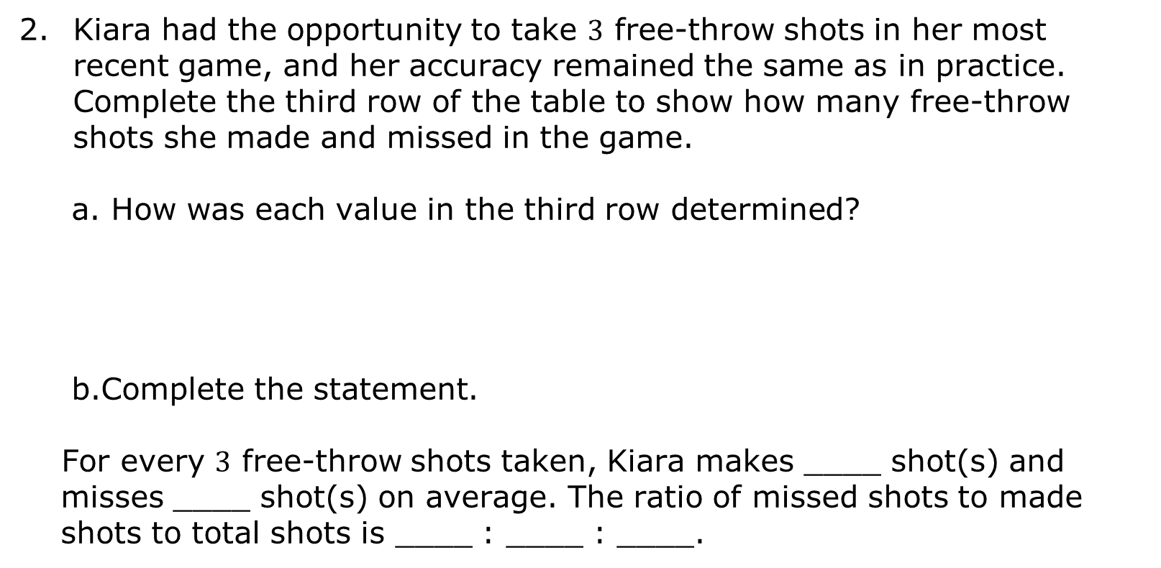
Kiara had the opportunity to take $3$ free-throw shots in her most recent game, and her accuracy remained the same as in practice. Complete the third row of the table to show how many free-throw shots she made and missed in the game.
How was each value in the third row determined?
Complete the statement.
For every $3$ free-throw shots taken, Kiara makes ____ shot(s) and misses ____ shot(s) on average. The ratio of missed shots to made shots to total shots is ____ : ____ : ____.
volume 1, pg. 289

Slide 11

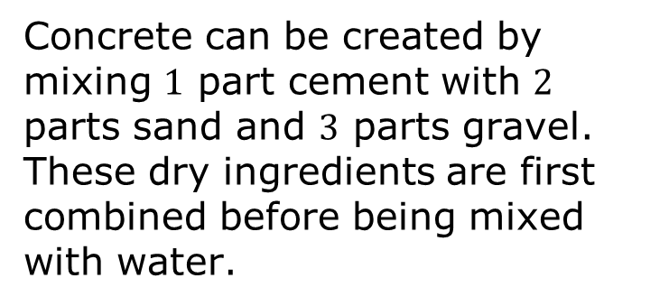
Three-column tables can also be useful when comparing mixtures that contain more than two parts.
Concrete can be created by mixing $1$ part cement with $2$ parts sand and $3$ parts gravel. These dry ingredients are first combined before being mixed with water.
cement sand gravel
volume 1, pg. 289

Slide 12
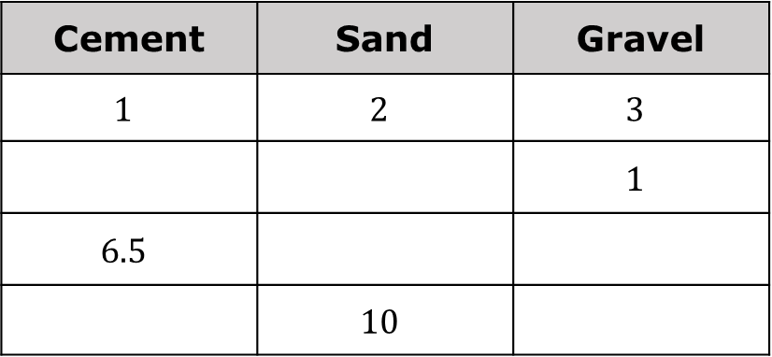
Complete the table to determine equivalent mixtures of concrete. Show how the values in each row are determined using arrows and by indicating the factor used.
Cement | Sand | Gravel
$$1$$ | $$2$$ | $$3$$
 |  | $$1$$
$$6.5$$
 | $$10$$
Marc uses one-gallon buckets to measure out the quantities needed in his concrete mixture. How many gallons of dry mix will he have in one batch of concrete?
volume 1, pg. 289

Slide 13

Guided Practice
volume 1, pg. 290

Slide 14

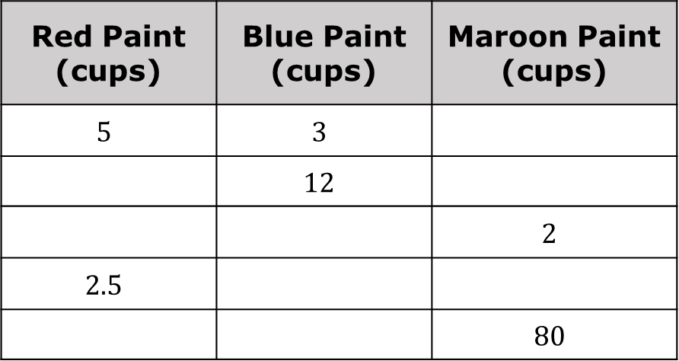
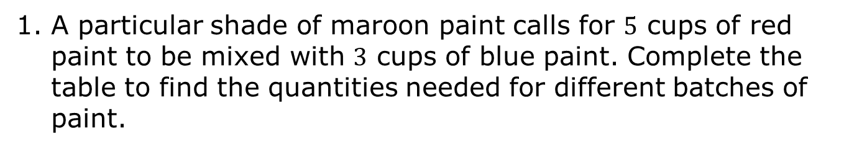
6.7.3 Guided Practice: Using Three-Column Ratio Tables
A particular shade of maroon paint calls for $5$ cups of red paint to be mixed with $3$ cups of blue paint. Complete the table to find the quantities needed for different batches of paint.
Red Paint (cups) | Blue Paint (cups) | Maroon Paint (cups)
$$5$$ | $$3$$
 | $$12$$
 |  | $$2$$
$$2.5$$
 |  | $$80$$
volume 1, pg. 290

Slide 15

If the mixture in the first row represents one batch of maroon paint, how many batches are in $80$ cups of maroon paint?
Explain how this relates to the factor used to complete the last row in the table.
volume 1, pg. 290

Slide 16
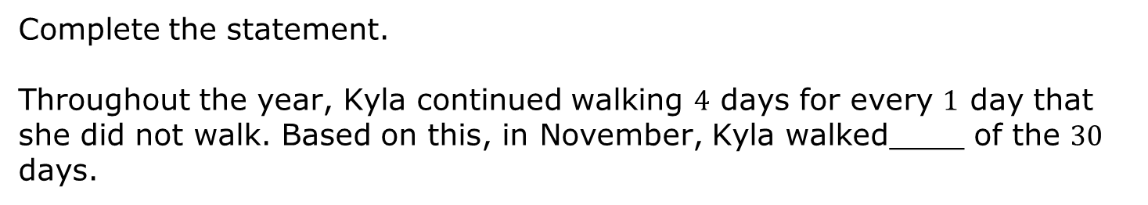
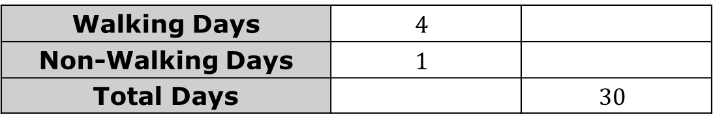
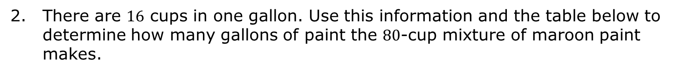
There are $16$ cups in one gallon. Use this information and the table below to determine how many gallons of paint the $80$-cup mixture of maroon paint makes.
Cups | Gallons
3. In April, Kyla went for a walk on $4$ days for every $1$ day that she did not walk. There are $30$ days in April. Use this information to complete the ratio table.
Walking Days | $$4$$
Non-Walking Days | $$1$$
Total Days |  | $$30$$
Complete the statement.
Throughout the year, Kyla continued walking $4$ days for every $1$ day that she did not walk. Based on this, in November, Kyla walked____ of the $30$ days.
volume 1, pg. 290

Slide 17

Your Turn
volume 1, pg. 291

Slide 18
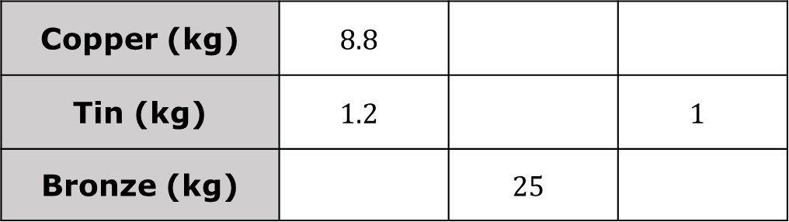
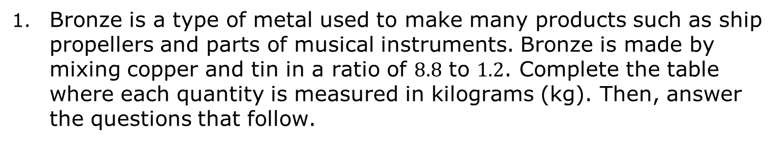
6.7.4 Your Turn!
Bronze is a type of metal used to make many products such as ship propellers and parts of musical instruments. Bronze is made by mixing copper and tin in a ratio of $8.8$ to $1.2$. Complete the table where each quantity is measured in kilograms (kg). Then, answer the questions that follow.
Copper (kg) | $$8.8$$
Tin (kg) | $$1.2$$ |  | $$1$$
Bronze (kg) |  | $$25$$
volume 1, pg. 291

Slide 19
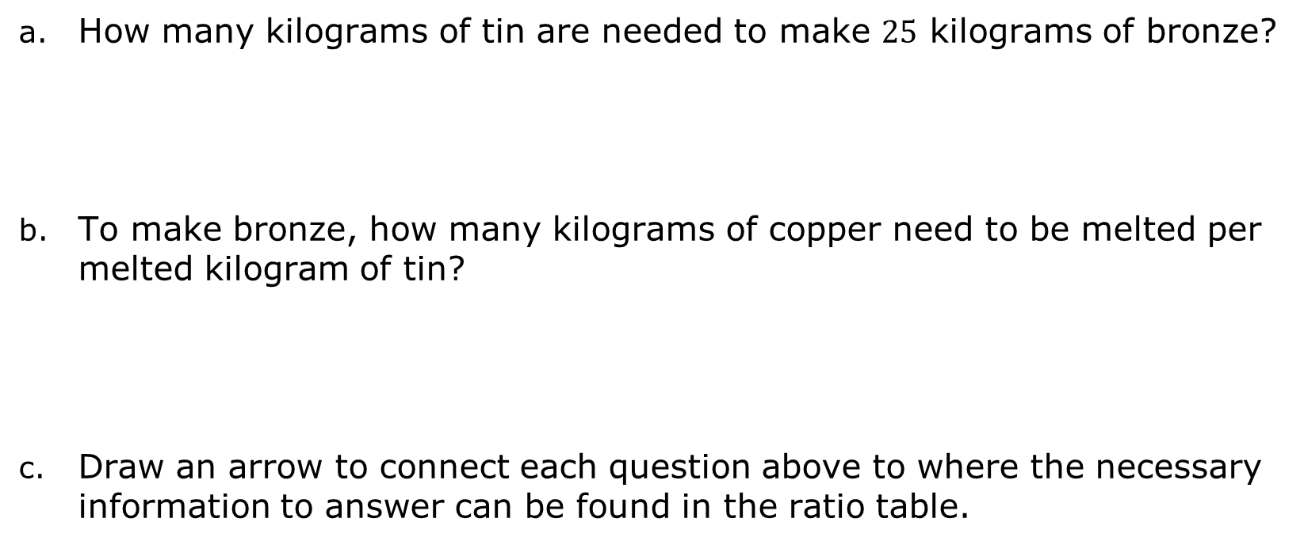
How many kilograms of tin are needed to make $25$ kilograms of bronze?
To make bronze, how many kilograms of copper need to be melted per melted kilogram of tin?
Draw an arrow to connect each question above to where the necessary information to answer can be found in the ratio table.
volume 1, pg. 291

Slide 20

Wrap-Up
volume 1, pg. 291

Slide 21
6.7.5 Wrap-Up: Cool Down
Write a short note to a friend who missed class that summarizes today’s lesson.
volume 1, pg. 291

